Slide 1

Alzheimer’s Disease Progression Analysis
A comprehensive exploration of key factors influencing Alzheimer's disease
Notes:
JADE

Slide 2
Introduction
Neurodegenerative diseases like Alzheimer’s and Parkinson’s progress gradually, often going undiagnosed until significant damage has occurred. Early prediction of disease progression can enable:
Timely Interventions to slow cognitive decline.
Personalized Treatment Plans based on patient risk factors
Improved Healthcare Resource Allocation for better patient outcomes.
This project explores how machine learning can analyze patient data—such as demographic trends, medical history, biomarkers, and cognitive tests—to predict disease progression and assist doctors in making informed treatment decisions.
Notes:
JADE

Slide 3
What is Alzheimer’s Disease?
Alzheimer’s disease is a progressive brain disorder that affects memory, thinking, and behavior.
Most common cause of dementia, accounting for 60-80% of cases.
Caused by abnormal protein buildup in the brain, leading to cell death.
Symptoms worsen over time, affecting daily life and independence.
No cure, but treatments can help manage symptoms and improve quality of life.
Notes:
JADE

Slide 4
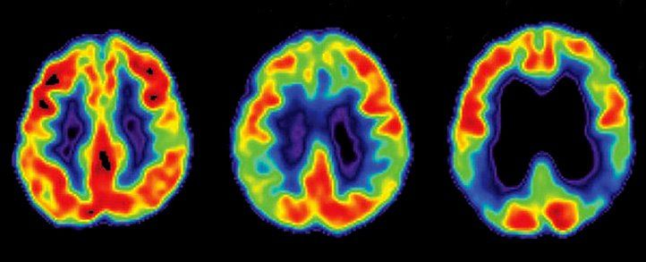
Alzheimer’s disease progresses through several stages, each with increasing cognitive decline
Early Stage (Mild) – Minor memory lapses, difficulty with familiar tasks, mild confusion
Middle Stage (Moderate) – Increased memory loss, difficulty recognizing people, trouble with language and reasoning
Late Stage (Severe) – Significant cognitive decline, inability to communicate, loss of physical abilities, full-time care needed
Notes:
JADE
Alzheimer’s disease progresses through distinct stages, gradually impairing cognitive and physical abilities.
The disease affects different parts of the brain over time, which leads to worsening symptoms.
The progression of this disease occurs over the span of years moving from mild cognitive impairment to severe dementia which is also known as Late Stage.

Slide 5
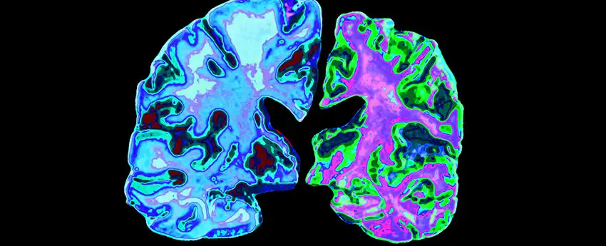
Causes & Risk Factors
Genetic predisposition
Age
Lifestyle factors
Cardiovascular Health
Notes:
JADE
The key causes and risk factors associated with the development of Alzheimer’s disease. While the exact cause is still not fully understood, several contributing factors have been identified:
Genetic predisposition plays a significant role, particularly if there’s a family history of Alzheimer’s. Certain genes, like APOE-e4, have been linked to increased risk.
Age is the most significant risk factor, with the majority of cases occurring in individuals over the age of 65. As we age, changes in the brain make it more vulnerable to Alzheimer’s-related damage.
Lifestyle factors also influence risk. Diet, exercise, smoking habits, and alcohol consumption can all impact brain health. Poor choices in these areas may accelerate cognitive decline.
Cardiovascular health is another critical factor. Conditions such as uncontrolled high blood pressure, diabetes, and obesity can increase the likelihood of developing Alzheimer’s, as these conditions affect blood flow to the brain.
Diagnosis typically involves a combination of clinical evaluations, cognitive tests like the MMSE, brain imaging, and biomarker analysis. These tools help detect early signs and provide a clearer understanding of disease progression.
Understanding these risk factors is essential for early intervention and potential prevention strategies.

Slide 6
Dataset Overview
Number of patients: 2,149
Number of variables: 35
Key aspects analyzed: Age, Gender, BMI, Education, Medical History, Cognitive Scores
No missing values detected
Notes:
JADE

Slide 7
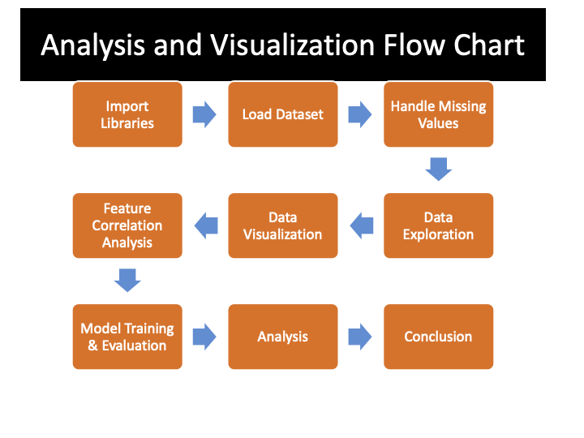
Notes:
ANDREW
Describe the path for how data was cleaned/ ETL (Extract, Translate, Load)
Brief description of:
What features were dropped?
Which features were significant
Segway into visualizations …. After describing flow chart
Describe what Alz Disease characteristics were found after cleaning data
Explain these observation in the next 5-6 graphs

Slide 8
Data Set Review (Rough outline add info or delete slide)
Describe the original data set here:
1) Where did it come from?
--Kaggle download
-- main file = “alzherimer’s disease data”
-- File type (.csv)
2) USE ANDREWS graphs/slides here to describe the master data set
--- What does MMSE stand for?
-- etc
3)How was the dataset analyzed/split/cleaned from main/original file?
--data set divided into 4-csv files, etc
1. Alz patient data
2. Alz feature importance
3. Alz. Predictions
4. Model optimization results
- Segway into flowchart review
Notes:
JADE

Slide 9
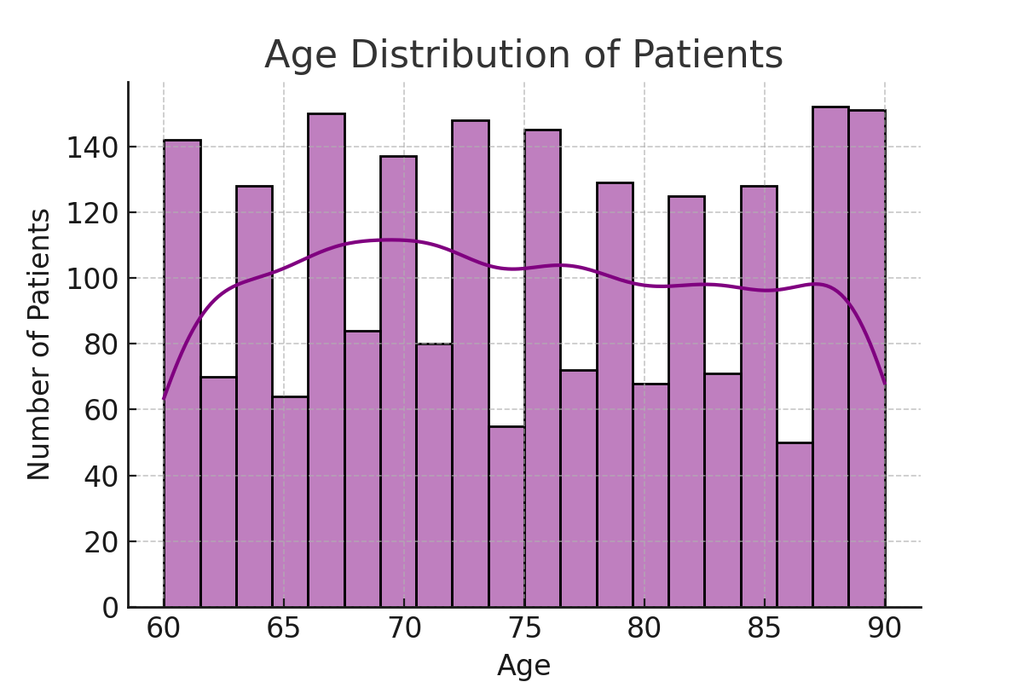
Age Distribution of Patients
Notes:
What the Graph Shows:
This histogram displays the distribution of ages among patients in the dataset.
The x-axis represents age, ranging from 60 to 90 years.
The y-axis represents the number of patients in each age group.
The purple line represents a smoothed density curve, showing the overall trend of age distribution.
📌 Key Insights:
The dataset primarily consists of older adults, with most patients between 60 and 90 years old.
The distribution appears relatively balanced, with some fluctuations in age frequency.
There is a slight peak around ages 65-75, suggesting that this dataset might contain more individuals in their mid-to-late 60s.
The number of patients remains fairly consistent across older ages, indicating a good representation of elderly individuals.
🔎 Discussion Points:
Why is age important?
Age is the biggest risk factor for Alzheimer’s disease, so understanding the distribution helps analyze disease prevalence across different age groups.
Are there enough younger patients for comparison?
Since this dataset focuses on older adults (60+), it may not provide insights into early-onset Alzheimer’s, which can occur in individuals under 60.
How does age relate to Alzheimer’s diagnosis?
We can analyze how Alzheimer’s diagnosis rates increase with age by comparing this graph with the diagnosis distribution.

Slide 10
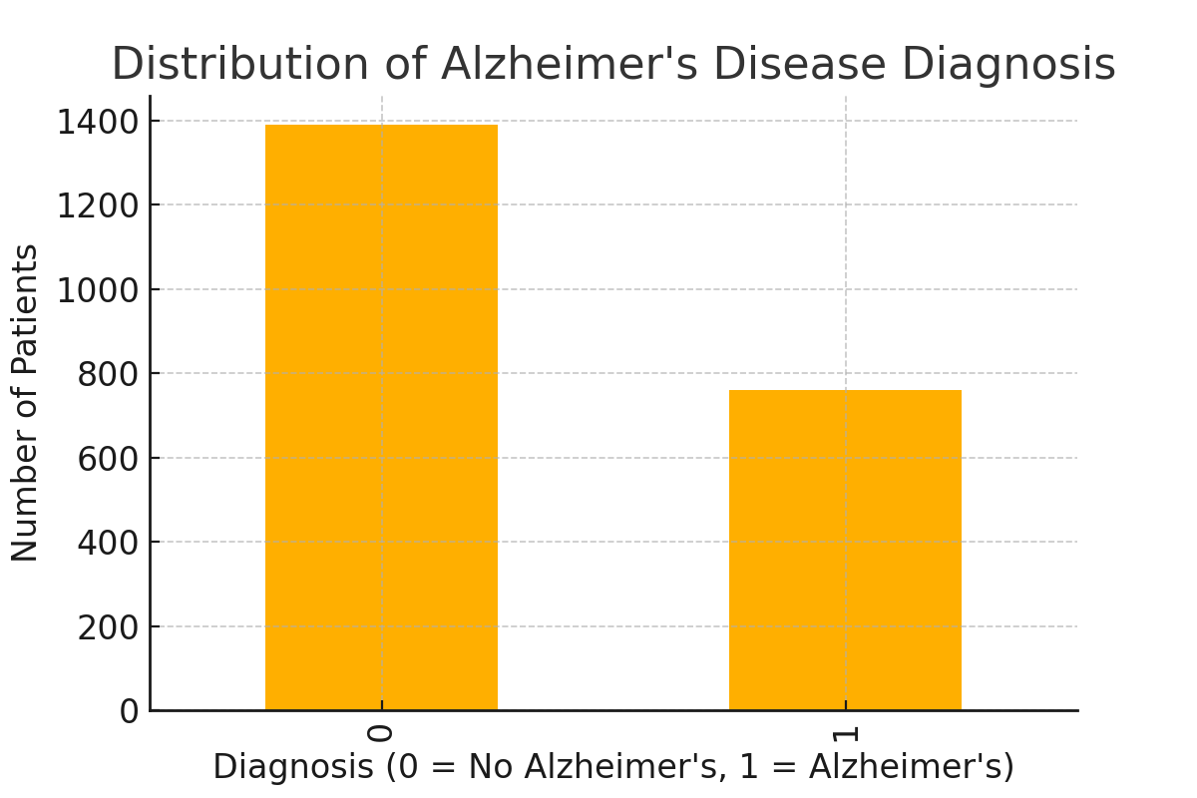
Alzheimer’s Disease Diagnosis Distribution
Notes:
Ths bar chart represents the distribution of patients diagnosed with Alzheimer’s disease (1) vs. those without (0).
The left bar (0) represents the number of patients without Alzheimer's, while the right bar (1) represents those diagnosed with the disease.
The height difference between the bars suggests that fewer people in the dataset have been diagnosed with Alzheimer's compared to those who have not.
📌 Key Insights:
The number of non-diagnosed patients is significantly higher than the diagnosed group.
However, given that Alzheimer’s is a progressive disease, many individuals in the "0" category may still be at risk for developing cognitive impairment over time.
If the dataset includes older individuals, the proportion of diagnosed cases might increase due to the strong correlation between age and Alzheimer’s risk.
🔎 Discussion Points:
Is this dataset representative? If this data comes from a population with a low overall Alzheimer’s prevalence, it could impact our ability to detect meaningful trends.

Slide 11
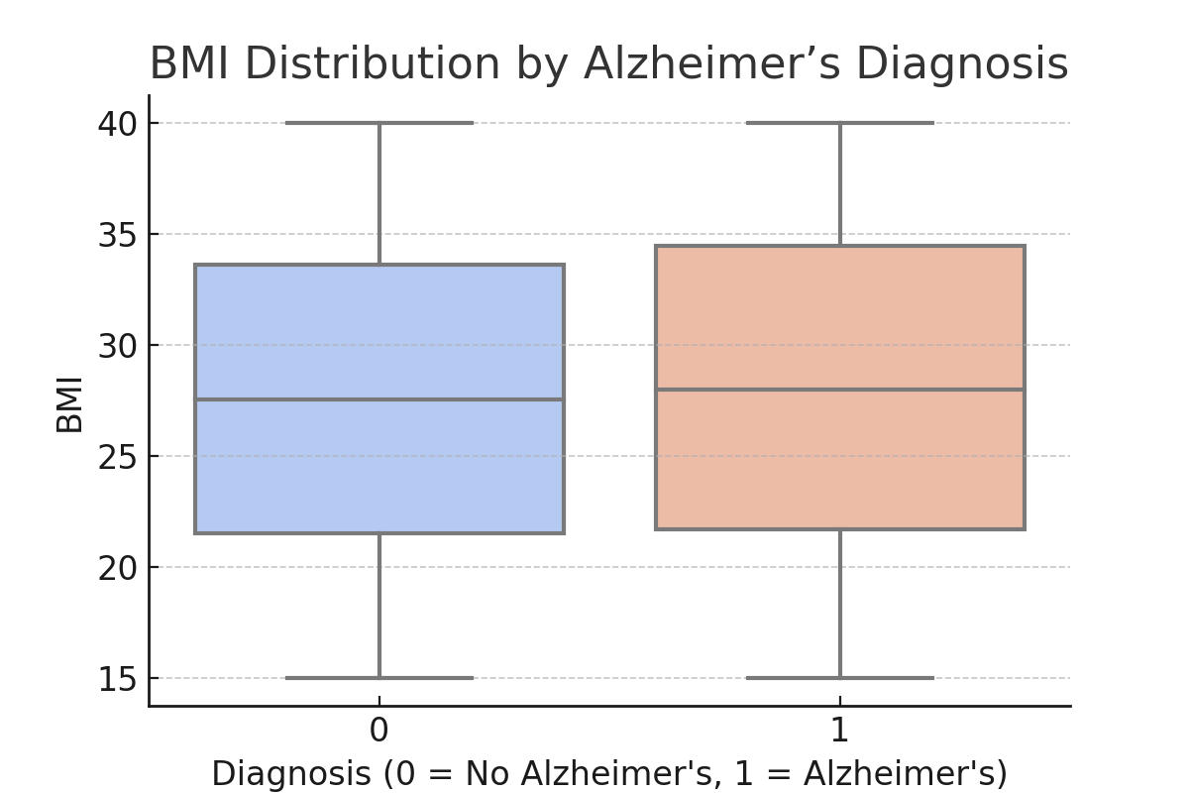
BMI Distribution by Alzheimer’s Diagnosis
Notes:
Talking Points for the Box Plot
📊 What the Box Plot Shows:
This plot compares BMI (Body Mass Index) distribution between patients with and without Alzheimer’s.
X-axis: Diagnosis categories:
0 → Patients without Alzheimer’s (blue box).
1 → Patients diagnosed with Alzheimer’s (peach box).
Y-axis: BMI values, showing how body weight varies among these groups.
Each box represents the middle 50% of BMI values, with the median (middle line in each box) indicating the central tendency.
The whiskers (vertical lines) extend to show minimum and maximum BMI values, excluding outliers.
📌 Key Insights:
BMI distribution appears similar between both groups, suggesting that there may not be a strong direct link between BMI and Alzheimer’s diagnosis in this dataset.
Both groups have a similar median BMI, meaning the average BMI is nearly the same for diagnosed and non-diagnosed individuals.
The spread of BMI values is also comparable, indicating that both underweight and overweight individuals exist in both groups.
However, BMI alone may not be sufficient to predict Alzheimer’s—it is often one of many contributing risk factors, alongside age, genetics, cardiovascular health, and lifestyle.
🔎 Discussion Points:
Is obesity a risk factor for Alzheimer’s?
Research suggests that obesity in midlife increases Alzheimer’s risk, but low BMI in later life may be a sign of disease progression.
How does BMI interact with other risk factors?
We can explore whether BMI correlates with cholesterol, hypertension, diabetes, or cognitive scores (MMSE).
Could weight loss indicate disease progression?
Sudden weight loss in elderly patients is sometimes linked to cognitive decline, possibly due to loss of muscle mass or metabolic changes in the brain.

Slide 12
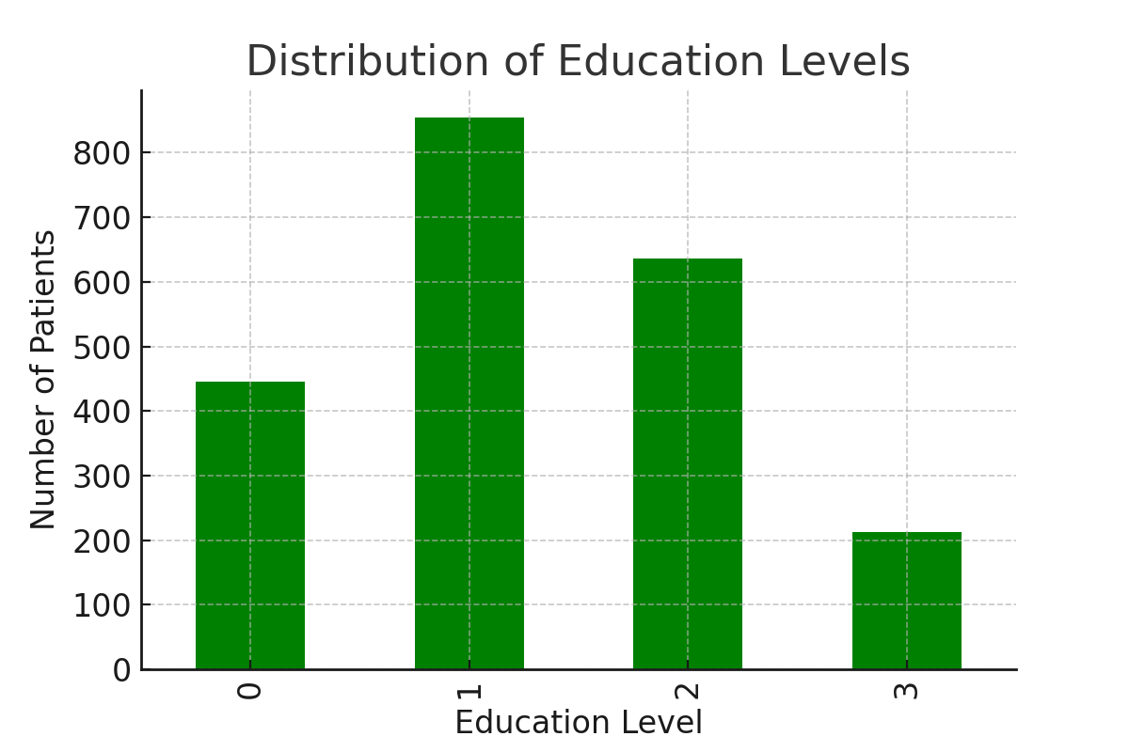
Education Level Distribution
Notes:
What the Graph Shows:
This bar chart represents the distribution of education levels among patients in the dataset.
The x-axis represents education levels (0, 1, 2, 3), while the y-axis represents the number of patients in each category.
Education Level 1 has the highest representation, followed by Level 2, Level 0, and then Level 3.
0 → No formal education or Primary school education1 → Some secondary education (e.g., middle school or partial high school)2 → High school diploma or equivalent3 → Higher education (e.g., college, university, or advanced degrees)
The dataset shows a diverse range of educational backgrounds, but higher education levels (3) have fewer patients.
📌 Key Insights:
Studies suggest that higher education may act as a protective factor against Alzheimer’s due to cognitive reserve, meaning the brain can better compensate for early damage.
If lower education levels correlate with higher Alzheimer’s diagnosis rates, this supports the idea that education contributes to cognitive resilience.
The smaller number of highly educated patients (Level 3) might make it difficult to analyze their risk in detail.
🔎 Discussion Points:
Does education level influence cognitive test scores (MMSE)?
People with higher education might score better on MMSE tests, even if they are in early stages of Alzheimer's.
How does education interact with other risk factors?
Patients with lower education may also have different lifestyle factors (e.g., diet, healthcare access, physical activity) that affect Alzheimer’s risk.
How can this data inform public health strategies?
Promoting lifelong learning, cognitive training, and mental engagement may help delay cognitive decline.

Slide 13
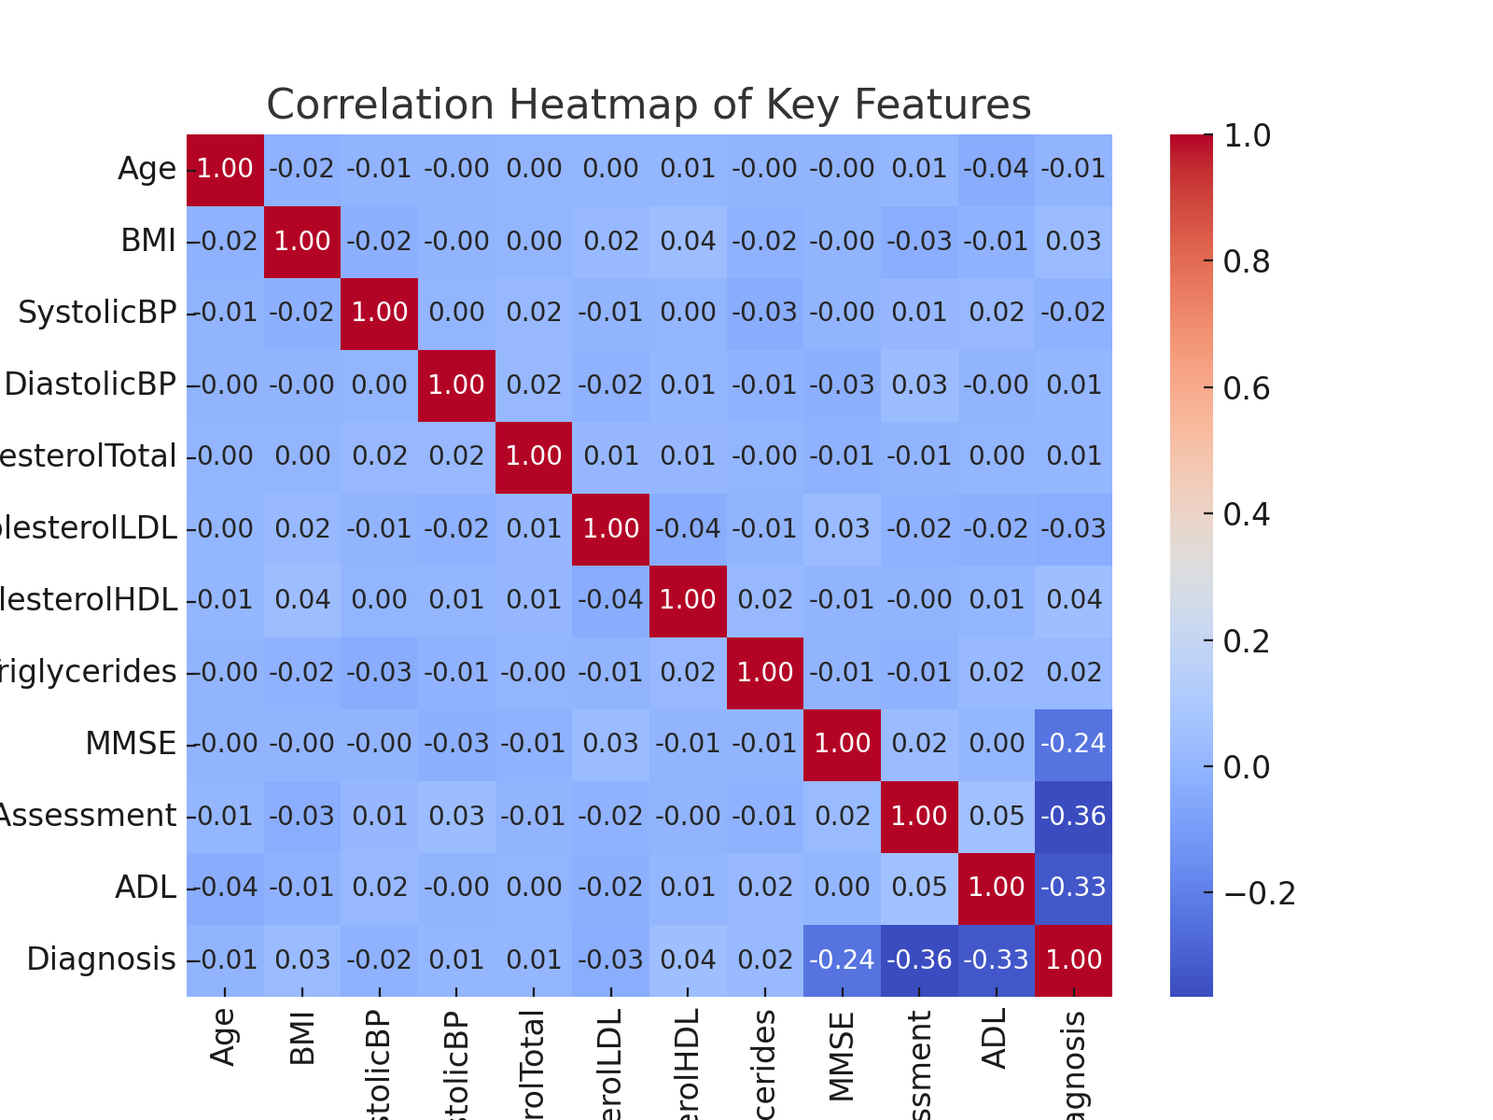
Correlation Heatmap of Key Features
Notes:
What the Heatmap Shows:
This heatmap visualizes correlations between key medical and cognitive features in the dataset.
Color Interpretation:
Red areas (closer to +1) → Strong positive correlation (when one factor increases, the other also increases).
Blue areas (closer to -1) → Strong negative correlation (when one factor increases, the other decreases).
Lighter shades → Weak or no correlation.
The correlation values range from -1 to +1, with 0 indicating no correlation.
📌 Key Insights:
Age vs. MMSE Score (-0.24)
Negative correlation suggests that cognitive function (MMSE) declines with age, supporting existing research on Alzheimer’s progression.
Age vs. Diagnosis (+0.23)
A positive correlation indicates that older individuals are more likely to be diagnosed with Alzheimer’s.
ADL (Activities of Daily Living) vs. Diagnosis (-0.33)
A moderate negative correlation means that as Alzheimer’s diagnosis increases, the ability to perform daily tasks decreases.
This aligns with the fact that Alzheimer’s progressively impairs independence and cognitive function.
MMSE vs. Diagnosis (-0.24)
A negative correlation suggests that lower MMSE scores are associated with higher likelihood of Alzheimer’s diagnosis.
MMSE is a critical cognitive test, and this correlation confirms its effectiveness in detecting cognitive decline.
Systolic BP, Cholesterol, and BMI
These features show weak correlations with diagnosis, suggesting that vascular health factors may not be strong standalone predictors of Alzheimer’s in this dataset.
However, they might still contribute indirectly through other risk factors like diabetes, hypertension, and obesity.
🔎 Discussion Points:
How reliable are MMSE scores for early detection?
If MMSE correlates with diagnosis, it reinforces its role as a useful cognitive screening tool.
Should we explore other risk factors?
Since BMI and cholesterol don’t show strong correlations here, could genetic factors or lifestyle variables be more significant?
Could intervention strategies slow cognitive decline?
If we focus on ADL and MMSE scores, could early cognitive training or lifestyle changes delay Alzheimer’s onset?

Slide 14
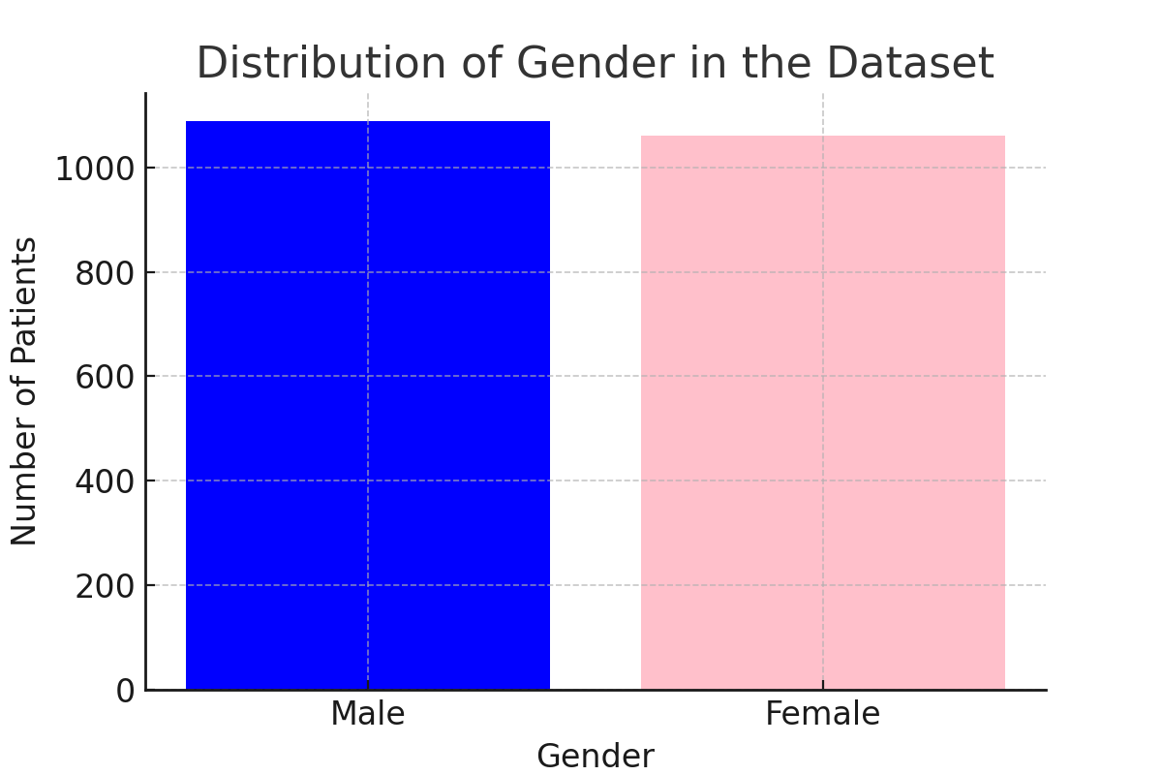
Gender Distribution
Notes:
What the Graph Shows:
This bar chart illustrates the gender distribution of patients in the dataset.
The x-axis represents gender, divided into Male (blue) and Female (pink).
The y-axis represents the number of patients in each gender category.
The two bars appear to be almost equal, indicating a fairly balanced gender representation.
📌 Key Insights:
The dataset contains a similar number of male and female patients, which helps ensure that gender-based differences in Alzheimer’s risk can be analyzed effectively.
Women are more likely to develop Alzheimer’s than men, as studies show that nearly two-thirds of Alzheimer’s patients are female.
If further analysis shows that women in the dataset have a higher diagnosis rate, it could support existing research on hormonal, genetic, or lifestyle factors influencing Alzheimer’s.
🔎 Discussion Points:
How does gender affect Alzheimer’s risk?
Research suggests estrogen loss in postmenopausal women may increase the risk of cognitive decline.
Are there gender differences in cognitive test scores?
Further analysis could compare MMSE scores between men and women to see if one group experiences faster cognitive decline.
Is there a difference in lifestyle factors?
Since gender can influence exercise habits, diet, and healthcare access, we could explore whether these factors contribute to differences in Alzheimer’s risk.

Slide 15


Key Data set features
Notes:
ANDREW
What the Graph Shows:
This bar chart illustrates the gender distribution of patients in the dataset.
The x-axis represents gender, divided into Male (blue) and Female (pink).
The y-axis represents the number of patients in each gender category.
The two bars appear to be almost equal, indicating a fairly balanced gender representation.
📌 Key Insights:
The dataset contains a similar number of male and female patients, which helps ensure that gender-based differences in Alzheimer’s risk can be analyzed effectively.
Women are more likely to develop Alzheimer’s than men, as studies show that nearly two-thirds of Alzheimer’s patients are female.
If further analysis shows that women in the dataset have a higher diagnosis rate, it could support existing research on hormonal, genetic, or lifestyle factors influencing Alzheimer’s.
🔎 Discussion Points:
How does gender affect Alzheimer’s risk?
Research suggests estrogen loss in postmenopausal women may increase the risk of cognitive decline.
Are there gender differences in cognitive test scores?
Further analysis could compare MMSE scores between men and women to see if one group experiences faster cognitive decline.
Is there a difference in lifestyle factors?
Since gender can influence exercise habits, diet, and healthcare access, we could explore whether these factors contribute to differences in Alzheimer’s risk.

Slide 16



Key Data set features pt. 2
Notes:
ANDREW
What the Graph Shows:
This bar chart illustrates the gender distribution of patients in the dataset.
The x-axis represents gender, divided into Male (blue) and Female (pink).
The y-axis represents the number of patients in each gender category.
The two bars appear to be almost equal, indicating a fairly balanced gender representation.
📌 Key Insights:
The dataset contains a similar number of male and female patients, which helps ensure that gender-based differences in Alzheimer’s risk can be analyzed effectively.
Women are more likely to develop Alzheimer’s than men, as studies show that nearly two-thirds of Alzheimer’s patients are female.
If further analysis shows that women in the dataset have a higher diagnosis rate, it could support existing research on hormonal, genetic, or lifestyle factors influencing Alzheimer’s.
🔎 Discussion Points:
How does gender affect Alzheimer’s risk?
Research suggests estrogen loss in postmenopausal women may increase the risk of cognitive decline.
Are there gender differences in cognitive test scores?
Further analysis could compare MMSE scores between men and women to see if one group experiences faster cognitive decline.
Is there a difference in lifestyle factors?
Since gender can influence exercise habits, diet, and healthcare access, we could explore whether these factors contribute to differences in Alzheimer’s risk.

Slide 17
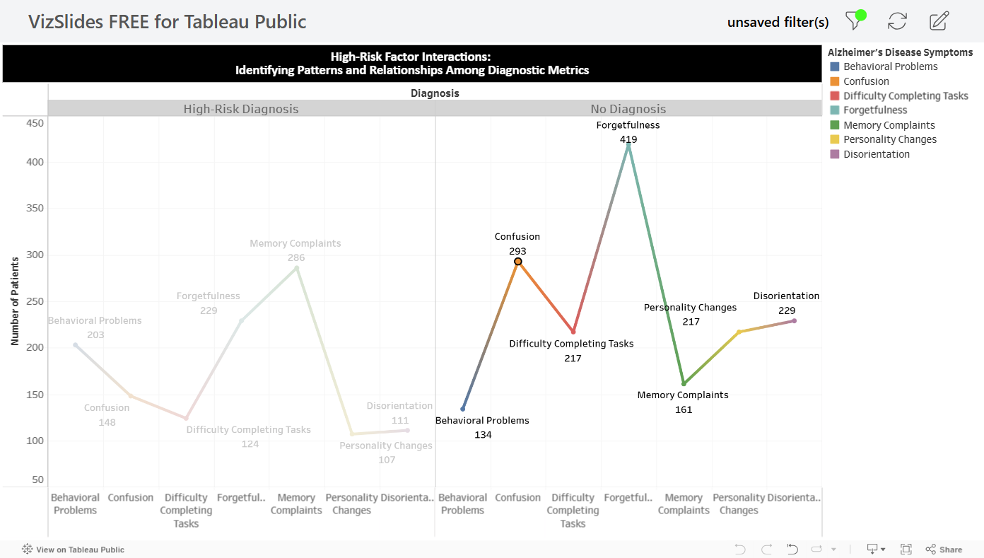
Alzheimer's Disease Associated Symptoms
Notes:
ANDREW
This visualization presents a side-by-side comparison of key Alzheimer's disease symptoms—such as behavioral problems, confusion, difficulty completing tasks, forgetfulness, memory complaints, personality changes, and disorientation—between individuals with a formal diagnosis and those without. The line chart helps us observe how these symptoms present and progress differently in each group. Noticing these distinctions is crucial, as it can highlight early indicators that may warrant further clinical evaluation. It also illustrates how treatment measures can help to lessen the symptoms when a patient is accurately diagnosed.
Make observations here

Slide 18
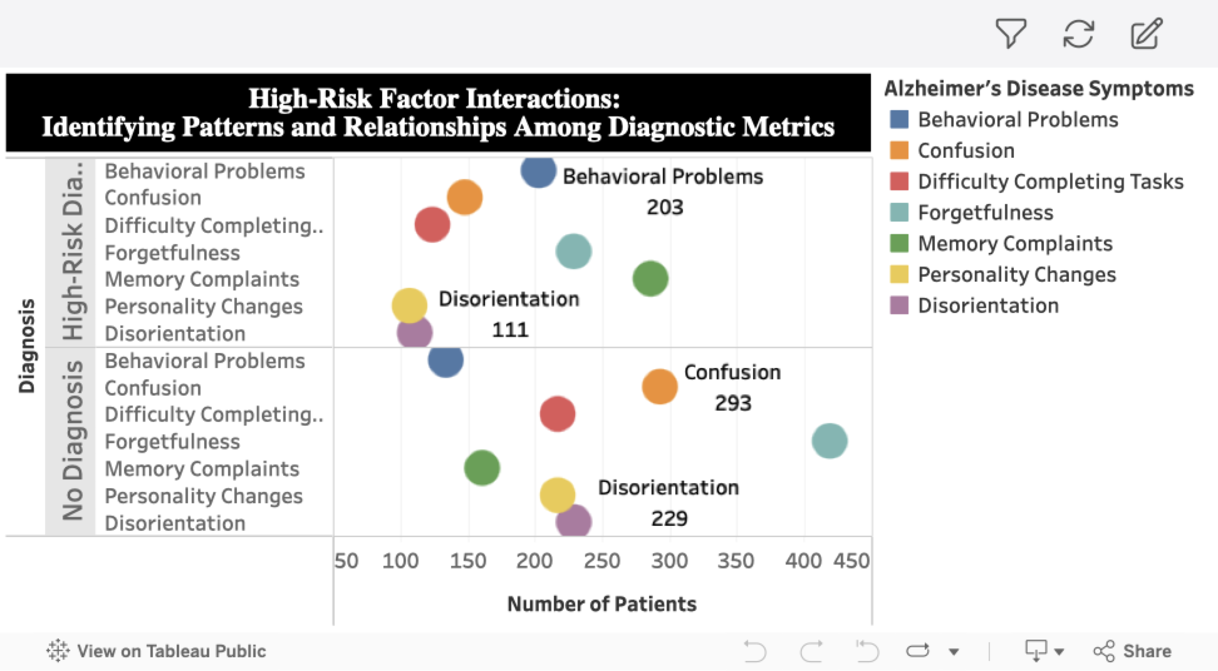
Distribution of Patient Symptoms
Notes:
ERIC
This scatter plot visualizes the relationship between Alzheimer's disease symptoms and patient diagnosis rates. The x-axis represents the number of patients, while the y-axis indicates diagnosis status. Each dot corresponds to a specific symptom—such as behavioral problems, confusion, difficulty completing tasks, forgetfulness, memory complaints, personality changes, and disorientation—and the number of patients experiencing it. The distribution of these dots helps highlight which symptoms are most prevalent across the diagnosed population versus those without a diagnosis.

Slide 19
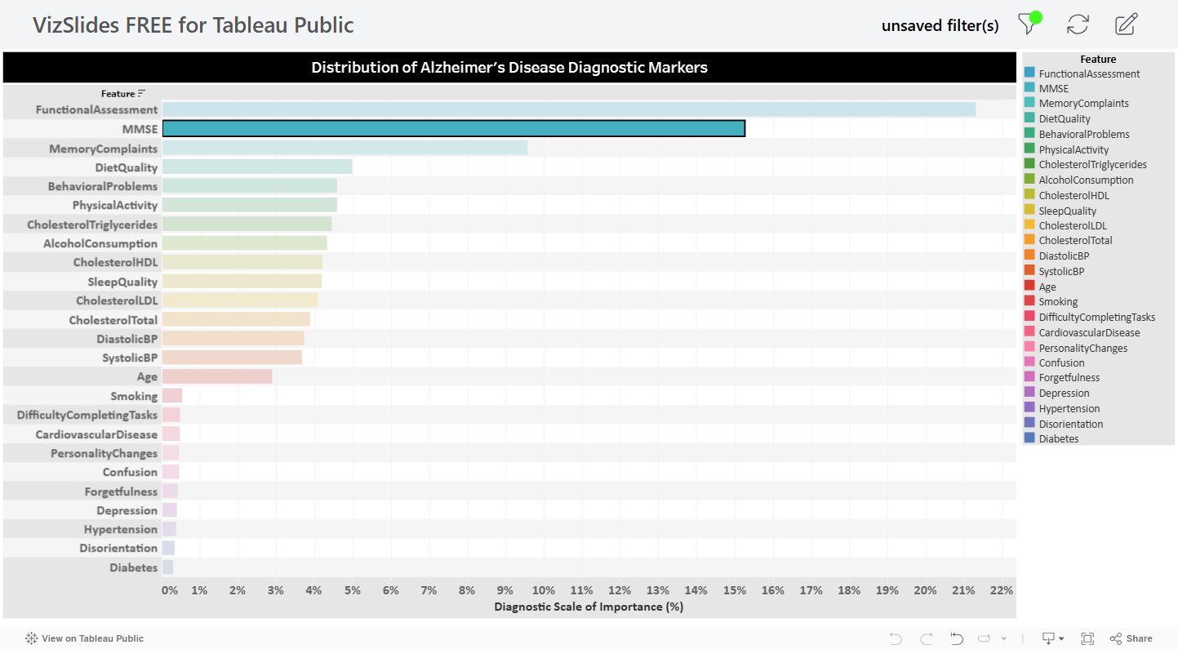
Disease Marker Importance
Notes:
CHRISTIAN
This bar graph highlights the relative importance of various disease markers in diagnosing Alzheimer's, measured as a percentage on the diagnostic scale. The features are listed on the y-axis, with the diagnostic importance percentage on the x-axis. Notably, the top three features contributing most to diagnosis are functional assessment scores, MMSE scores, and memory complaints. These markers stand out as the most significant indicators of cognitive decline and potential risk.

Slide 20
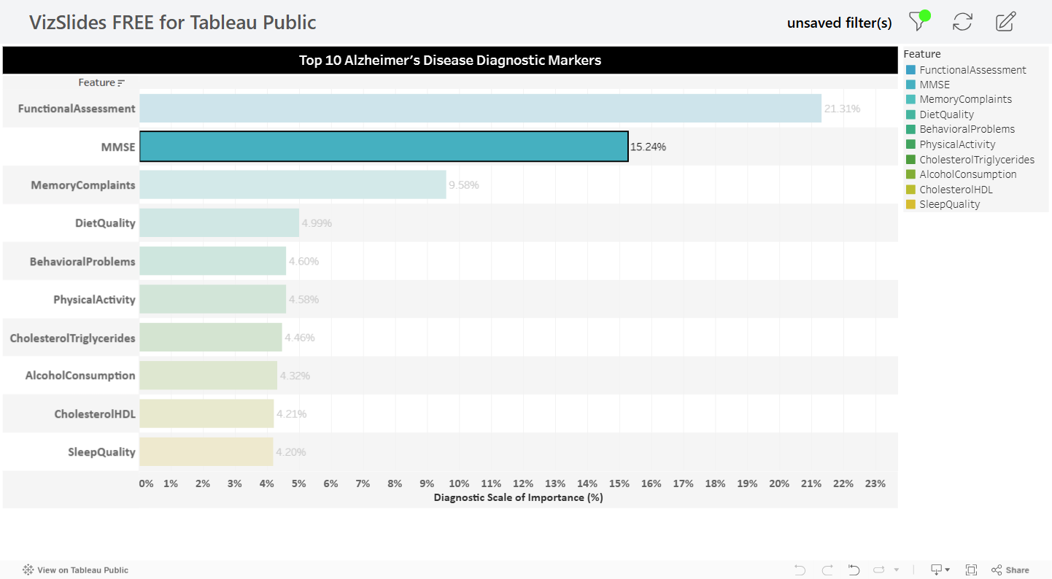
Most Significant Disease Markers
Notes:
CHRISTIAN
This bar graph reinforces our understanding of the most significant disease markers contributing to an Alzheimer's diagnosis. Similar to the previous slide, the diagnostic scale of importance is shown as a percentage along the x-axis, with the key features listed on the y-axis. Once again, the top three features—functional assessment, MMSE scores, and memory complaints—stand out as the strongest indicators of disease progression. This consistency across analyses highlights the critical role these markers play in identifying high-risk individuals. It is important to consider how emphasizing these markers could support more accurate diagnoses and earlier intervention strategies for care teams.

Slide 21
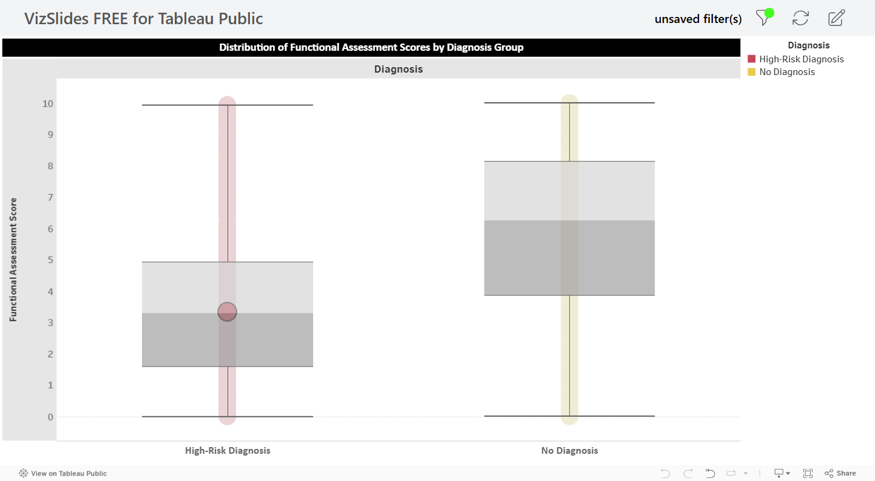
Functional Assessment Score vs Diagnostic Outcome
Notes:
CHRISTIAN
This box and whisker plot displays the distribution of functional assessment scores across two diagnosis groups: individuals with no diagnosis and those classified as high-risk. The functional assessment score, shown on the y-axis, reflects a patient's ability to perform daily living activities. By comparing these groups side by side, we can observe differences in median scores, the range of scores, and the variability within each group. Pay close attention to how the no diagnosis group shows a broader distribution, which could indicate greater challenges in daily functioning. This visualization helps us better understand how functional decline may correlate with diagnostic outcomes.
What is the functional assessment score and why is it important?
- The smaller the gray zone (square/box) = smaller variance, more consistent
- Larger gray zone (square/box) = bigger variance, less consistent

Slide 22
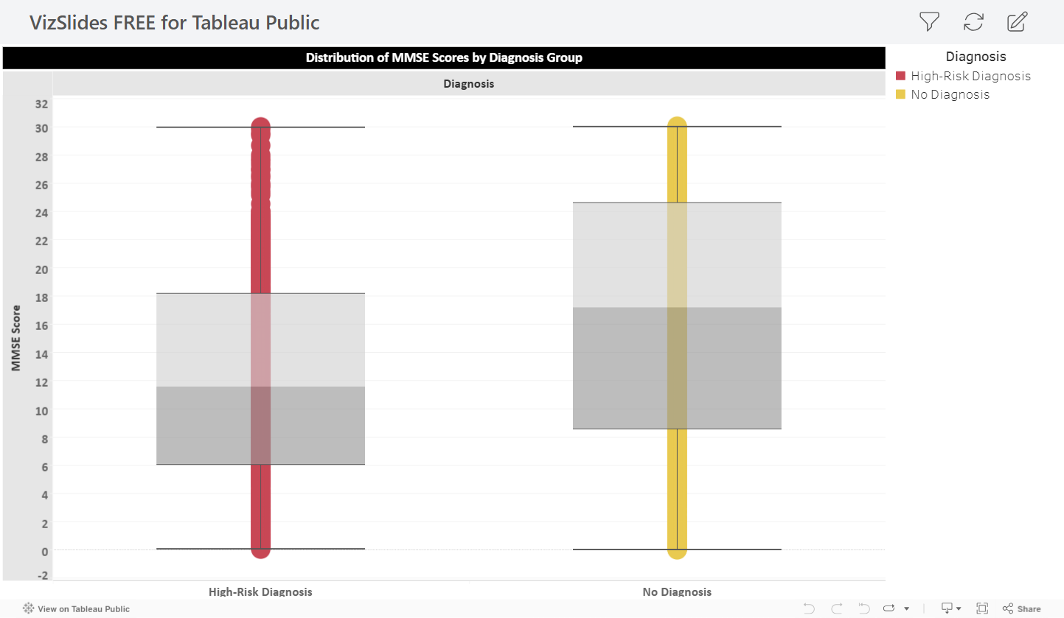
MMSE vs Diagnostic Outcome
Notes:
CHRISTIAN
This box and whisker plot illustrates the distribution of MMSE (Mini-Mental State Examination) scores across two diagnosis groups: individuals with no diagnosis and those identified as high-risk. The MMSE score, shown on the y-axis, is a key measure used to assess cognitive function. The side-by-side comparison allows us to observe differences in score ranges, medians, and variability between the two groups. Notice the spread of scores—especially as the high-risk group has lower median scores or a wider distribution, which could suggest greater variability in cognitive decline. This visualization helps highlight the cognitive differences that may signal an increased risk for Alzheimer's.
What does MMSE stand for and why is it important?
- The smaller the gray zone (square/box) = smaller variance, more consistent
- Larger gray zone (square/box) = bigger variance, less consistent

Slide 23
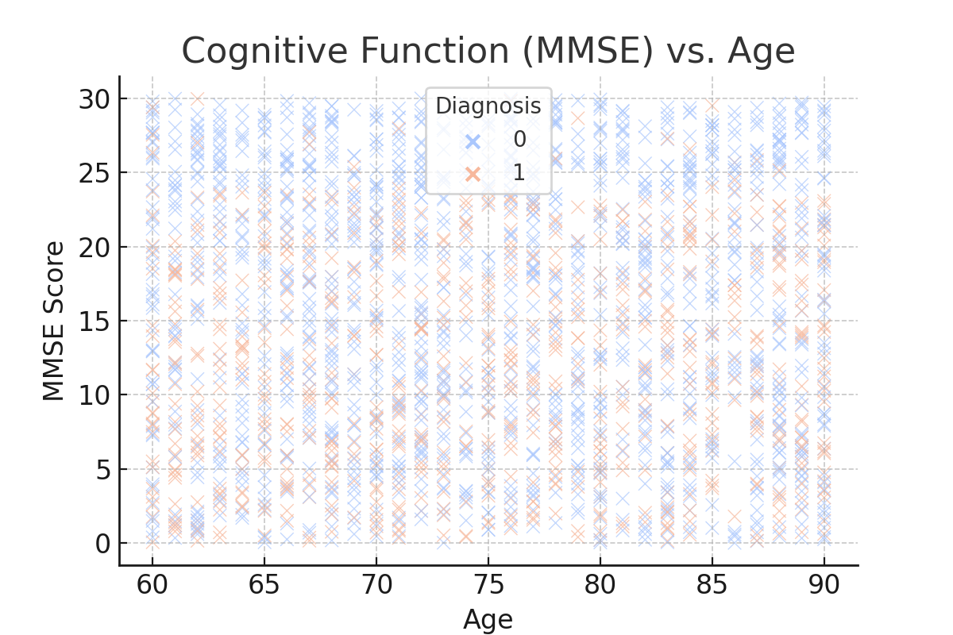
Cognitive Function (MMSE) vs. Age
Notes:
The Mini-Mental State Exam (MMSE) is a commonly used tool to assess cognitive function.
📊 What the Graph Shows:
This scatter plot displays the relationship between age and cognitive function as measured by the MMSE (Mini-Mental State Examination) score.
X-axis: Age of patients (60 to 90 years).
Y-axis: MMSE scores (range from 0 to 30, with higher scores indicating better cognitive function).
Color coding:
Blue (0) → Patients without Alzheimer's.
Orange (1) → Patients diagnosed with Alzheimer's.
📌 Key Insights:
Cognitive Decline with Age
There is a noticeable decline in MMSE scores as age increases, confirming that aging is strongly associated with cognitive decline.
Some older individuals still have high MMSE scores, suggesting that not everyone experiences severe cognitive impairment with age.
Diagnosis and MMSE Scores
Alzheimer’s patients (orange markers) tend to have lower MMSE scores, supporting the idea that MMSE is a useful tool for diagnosing cognitive impairment.
However, there is some overlap, meaning that some non-diagnosed patients also have low scores, possibly indicating early-stage cognitive decline.
Variability in Scores at Younger Ages
In patients aged 60-75, there is a wide range of MMSE scores, suggesting that early cognitive decline is not solely dependent on age.
Some younger individuals have low MMSE scores, which could be due to other risk factors like genetics, lifestyle, or medical conditions.
🔎 Discussion Points:
Can MMSE predict Alzheimer’s early?
If low MMSE scores occur in non-diagnosed patients, should they be monitored for early intervention?
What other factors impact cognitive function?
Age is a factor, but how do education, physical health, and lifestyle choices influence MMSE scores?
Could early screening improve outcomes?
If cognitive decline is detected early, could mental exercises, medication, or lifestyle changes slow progression?

Slide 24
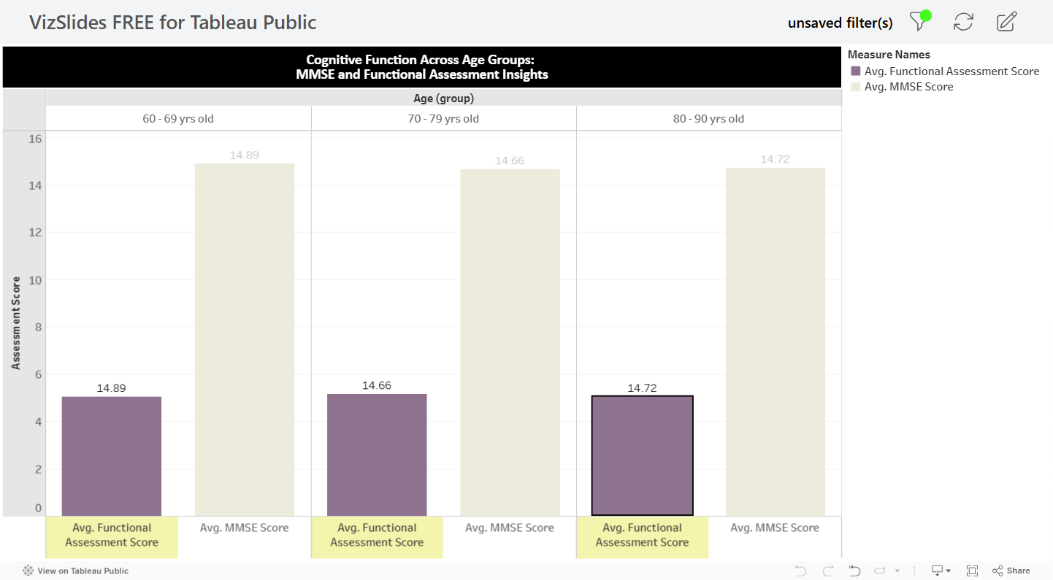
Cognitive Function vs Age
Notes:
CHRISTIAN
This table and corresponding bar charts display cognitive function insights across three age groups: 60-69, 70-79, and 80-90 years old. The charts compare the average scores from two key metrics—the Mini-Mental State Examination (MMSE) and functional assessment scores—for each age group. The MMSE assesses cognitive decline, while the functional assessment evaluates the ability to perform daily activities. As we analyze these visuals, notice how cognitive and functional scores shift with age, and consider how these trends can help identify when additional support or interventions may be most beneficial

Slide 25
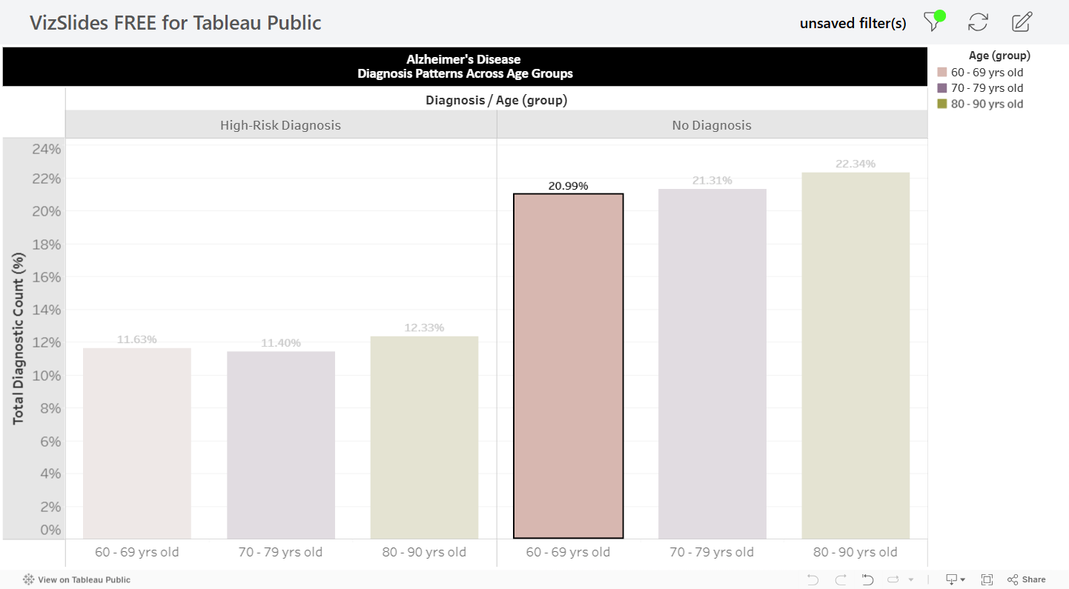
Diagnosis Patterns vs Age
Notes:
CHRISTIAN
This slide presents a side-by-side comparison of diagnosis patterns across age groups, with bars representing total diagnostic counts as a percentage. The chart is divided into two groups—those with a high-risk diagnosis and those without. Within each group, we have separate bars for the age ranges of 60-69, 70-79, and 80-90 years old. This visualization helps highlight how diagnosis rates vary by age and whether certain age groups show a higher prevalence of high-risk indicators. As we analyze the chart, pay attention to how the percentage of diagnoses slightly increases with age, offering insight into when individuals may be most vulnerable and when interventions could be most effective.

Slide 26
Model Performance Review
Brief description about what information is on the remaining 7-slides
Maybe insert another Alzheimer's picture here to transition?
Delete this slide
Notes:
ERIC

Slide 27
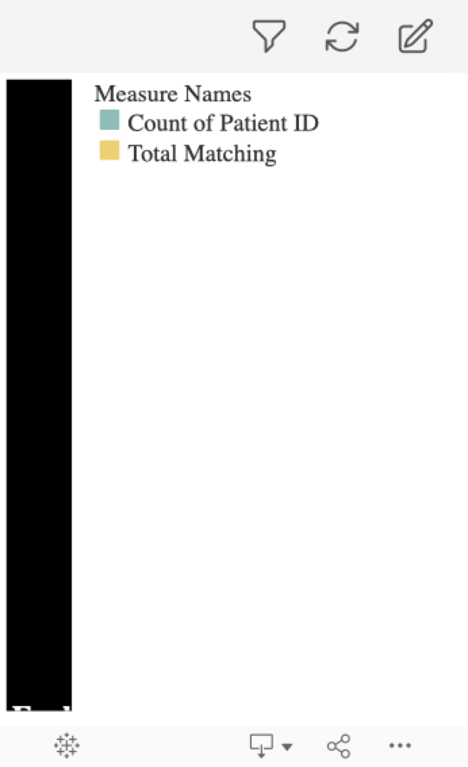
Model Outcome at a Glance
-What is being measured in this graph?
Correlation assessment
How many predicted outcomes match actual diagnostic outcomes
Create bullet points showing that here
DO we even need this graph?????
Notes:
ERIC

Slide 28
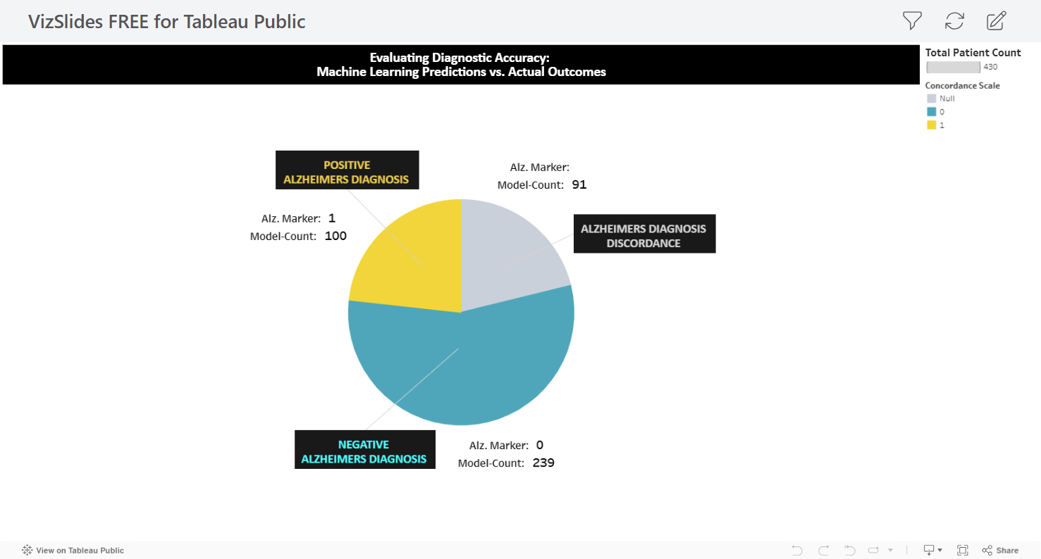
Correlation Overview
Notes:
ERIC
The number of data points (patients) tested/trained within model = 430
339 predicted outcomes out of 430 total data points,
correlated with actual Alzheimer’s disease diagnosis
91 predicted data points (patients) did not correlate/match with actual diagnostic outcomes
Add additional observations

Slide 29
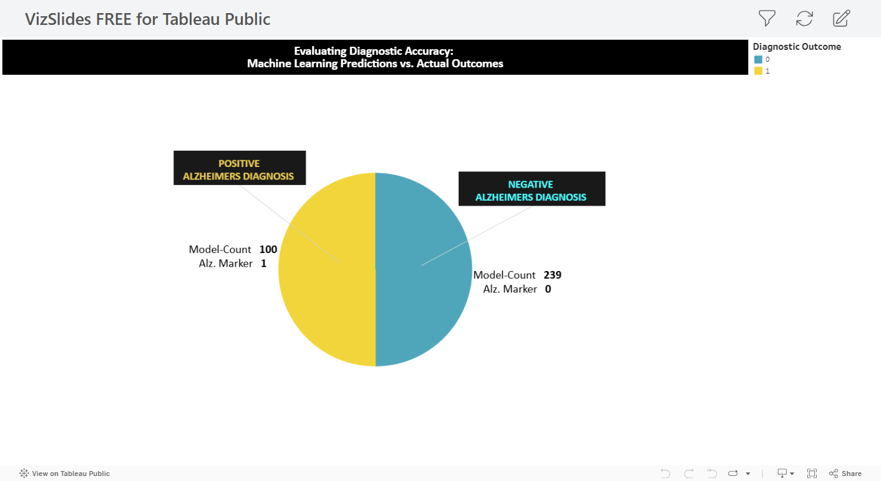
Distribution of Correlating Diagnostic Outcomes
Notes:
ERIC
From the 339 total matching outcomes:
100 positive “predicted” alz. Diagnoses match 100 actual alz. Diagnoses
239 negative “predicted” alz. Diagnoses match 239 actual alz. Diagnoses

Slide 30
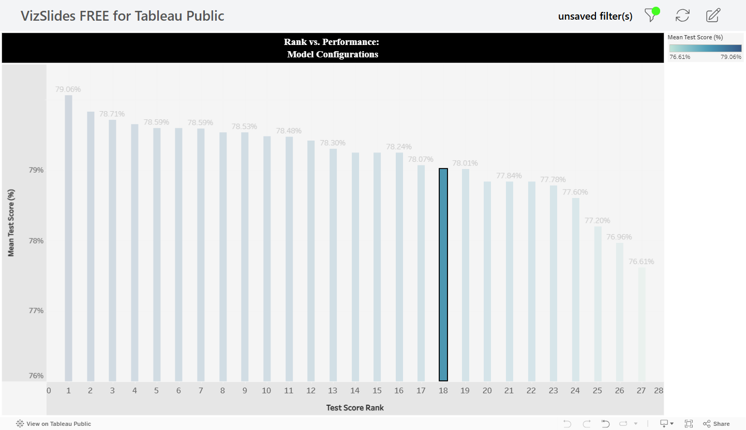
Model Performance Review
Notes:
ERIC
This slide provides an overview of our model's performance, visualized through a rank vs. performance bar chart. The x-axis displays the test score rank, while the y-axis shows the mean test score percentage. Each bar represents a different model configuration, helping us assess which setups delivered the highest levels of accuracy and reliability. We see with this chart what may influence model selection for future analyses. This insight is crucial for refining our approach and ensuring we prioritize the most effective models moving forward.

Slide 31
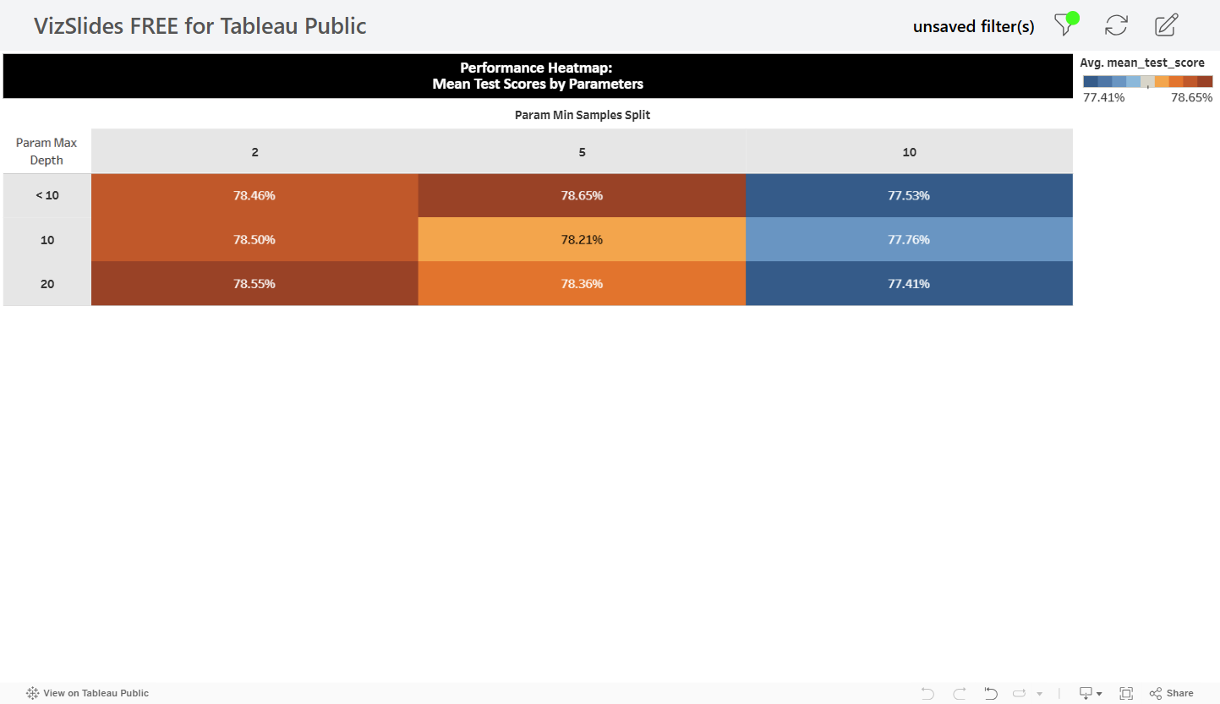
Top-Performing Parameter Combinations
Notes:
ERIC
This heatmap visualizes the performance of different parameter combinations in our model configuration. The focus is on three key parameters: max_depth, min_samples_split, and n_estimators. The color intensity indicates the mean test score for each combination, with darker shades representing higher performance.
Our analysis highlights that the combination of a max_depth of 10, min_samples_split of 5, and 50 estimators consistently produced the highest mean test score of 0.790 (79% accuracy). This configuration demonstrates an optimal balance between model complexity and generalization, reducing overfitting while maintaining accuracy.
These insights can guide us in fine-tuning the model for better predictive performance and stability.

Slide 32
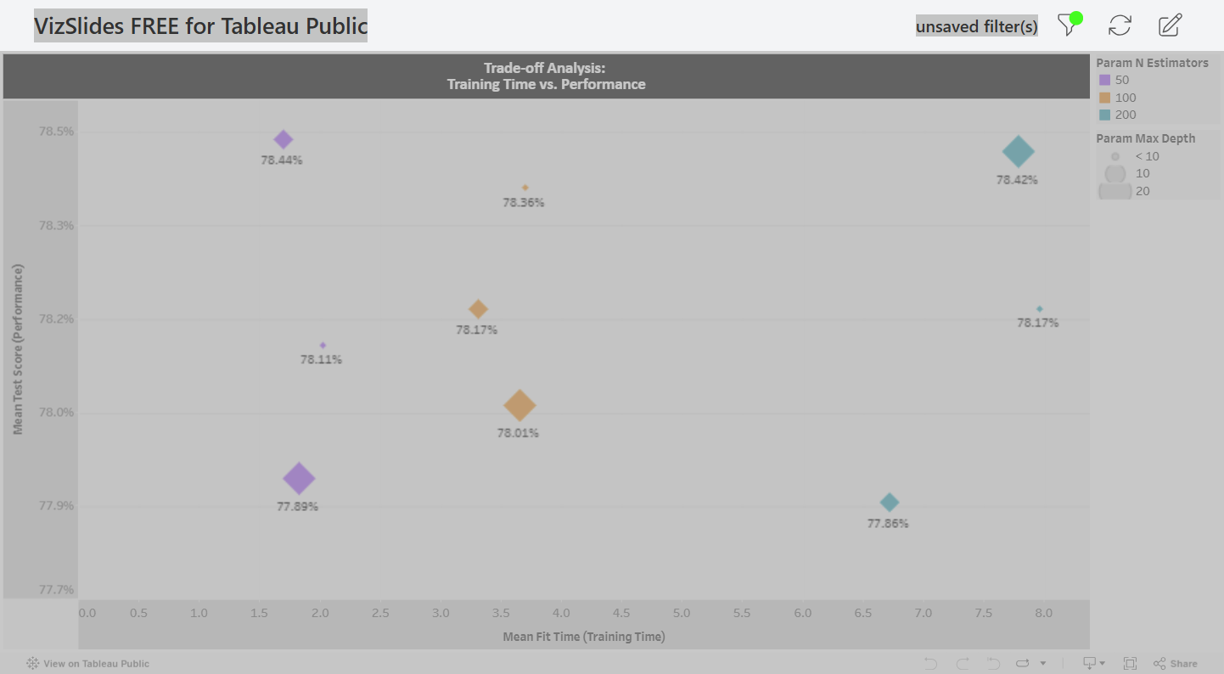
Trade-off Analysis Between Fit Time and Test Score
Notes:
ERIC
This scatter plot illustrates the trade-off between model training time and performance. The x-axis represents the mean fit time (or training time), while the y-axis shows the mean test score percentage. Each point corresponds to a different model configuration.
A key insight from this analysis is that configurations with n_estimators = 50 consistently offer competitive test scores while minimizing fit time. This makes them an efficient option when balancing performance with resource efficiency.
As we evaluate these results, it's important to consider how optimizing fit time without sacrificing accuracy can improve scalability and processing efficiency, especially when dealing with larger datasets or real-time applications.

Slide 33
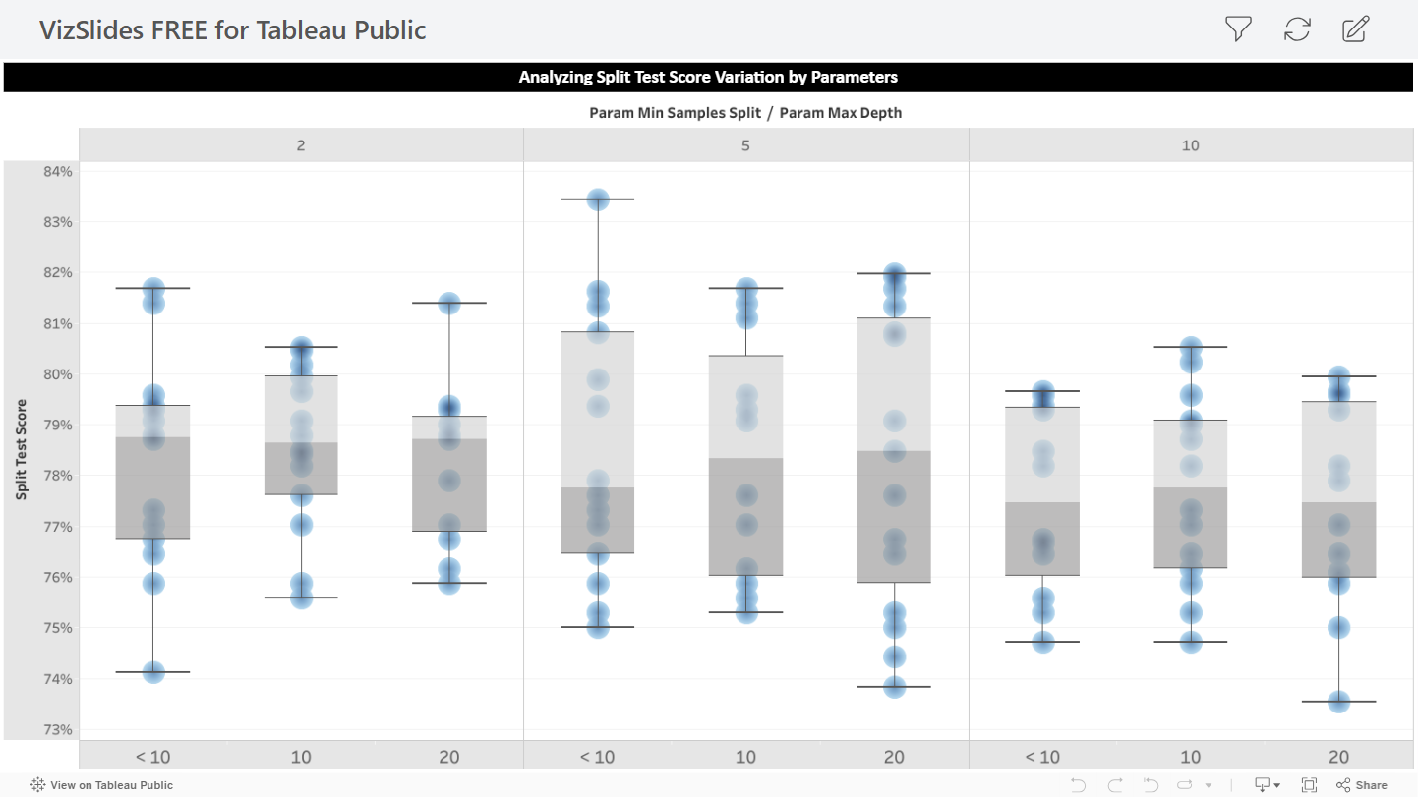
Consistency Across Splits
Notes:
Eric
This boxplot analyzes the variability in test scores across different data splits, from split0_test_score to split4_test_score, for various parameter combinations. The goal is to assess the consistency and stability of model performance.
One key observation is that configurations with max_depth=None and min_samples_split=2 exhibit higher variability across splits. This suggests less stability in performance, indicating that these models may be more sensitive to variations in the training data, which could lead to less reliable predictions.
Identifying these inconsistencies is crucial, as stable model performance across multiple data splits is essential for ensuring robustness and generalizability.

Slide 34

Conclusion
Summary of Key Findings: Highlighted significant risk factors, diagnostic markers, and trends related to Alzheimer's disease progression.
Importance of Early Detection: Emphasized how early identification of high-risk indicators can lead to better intervention strategies.
Model Performance Insights: Identified optimal parameter configurations that improve diagnostic accuracy and efficiency.
Implications for Future Research: Findings support the need for further exploration into age-related trends, symptom progression, and risk factor interactions.
Next Steps: Continue refining predictive models and expand analysis for broader applications in early diagnosis and prevention.
Final Takeaway: Proactive screening, lifestyle modifications, and advanced diagnostics are key in managing and mitigating Alzheimer's disease risk.
Notes:
Jade

